Slide 1
UNIT- 3:
Production, Cost, Market Structures and Pricing
BVRIT HYDERABAD College of Engineering for Women

Slide 2
Lecture plan
Introduction
Cost Based Pricing
Pricing Based on Firm’s Objectives
Competition Based Pricing
Product Life Cycle Based Pricing
Cyclical Pricing
Multi Product Pricing
Peak Load Pricing
Sealed Bid Pricing Strategy
Retail Pricing
Administered Pricing
https://www.slideshare.net/syed_shahzad786/product-life-cycle-and-pricing
BVRIT HYDERABAD College of Engineering for Women

Slide 3
Objectives
To introduce the rationale behind different pricing decisions of a firm.
To understand cost based, value based and perception based pricing strategies.
To relate product life cycle stages as well as different phases of business cycles with pricing decisions.
To see the effect of administered pricing on general pricing policies.
BVRIT HYDERABAD College of Engineering for Women

Slide 4
Introduction
Price denotes two aspects:
  It is revenue to the seller and
  It is the perceived value of the good (or service) to the buyer.
Firms take pricing decisions when
  a new product is to be launched.
  a product is modified (or improved)
  entering a new market or a new market segment,
  change in cost of production
Market structure also affects pricing decisions.
Change in government policy regarding taxation, subsidies and administered prices would also lead to change in existing price.
BVRIT HYDERABAD College of Engineering for Women

Slide 5
Cost Based Pricing
  Cost Plus or Mark up Pricing
  Price of the product is the sum of cost plus a profit margin.
  Also called Average Cost Pricing or Full Cost Pricing.
  A firm will consider total cost per unit or average cost (AFC+AVC) and determine a mark up, depending upon:
    target rate of return
    degree of competition
    price elasticity and
    availability of substitutes.
  Price arrived at would thus be:
    Price = AC+ m, where m is the percentage of markup.
BVRIT HYDERABAD College of Engineering for Women

Slide 6
Cost Based Pricing
Contd…
Marginal Cost Pricing
Also known as incremental cost pricing.
Price of the product is the sum of variable cost plus a profit margin.
Useful when demand is slack and market is highly competitive.
Target Return Pricing
A producer rationally decides the minimum rate of return that the product must earn.
Margin is decided on the basis of target rate of return, determined on the basis of:
  company’s experience
  consumers’ paying capacity,
  risk involved, etc.
BVRIT HYDERABAD College of Engineering for Women

Slide 7
Pricing Based on Firm’s Objectives
Profit Maximization:
  A firm which aims to earn maximum profit would adopt mark up pricing.
  The price charged by such firm would be the highest.
Sales Maximization:
  Firms who like to maximize sales instead of profit maximization.
  Such firms would have to adopt competitive pricing
  One such method can be marginal costing.
BVRIT HYDERABAD College of Engineering for Women

Slide 8
Competition Based Pricing
Penetration Pricing
  When a new firm plans to enter a market dominated by existing players, it charges a low price, even lower than the ongoing price.
  This is called penetration price.
  Principles of marginal costing are used in this case.
  Short term in perspective
  Success depends on the price elasticity of demand of the product
Entry Deterring Pricing
  If the prevailing price is already very low, new entrants with high fixed cost will not enter the market at a price lower than the prevailing price.
  Existing small players may not survive due to higher average cost.
  Also known as Limit Pricing.
  Success depends on the fact that the firm earns economies of scale and hence can afford to charge low price.
BVRIT HYDERABAD College of Engineering for Women

Slide 9
Competition Based Pricing
Going Rate Pricing
  Adopted when most of the players do not indulge in separate pricing but prefer to follow the prevailing market price.
  Normally the price is fixed by the dominant firm and other firms accept its leadership and follow that price.
    Because most firms do not want to enter into a price war kind of situation.
  Small or new firms may not be sure of shift in demand by charging a price different from the prevailing market price.
  Products sold by the players are very close substitutes
    Cross elasticity is very high.
  Popular in monopolistic and oligopoly markets where product differentiation is minimal and consumer’s switching cost is almost negligible.
BVRIT HYDERABAD College of Engineering for Women

Slide 10
Product Life Cycle Based Pricing
Price Skimming
A complete pricing package suitable for different life cycle stages of a product, i.e. high price at the time of introduction and lower price during maturity. (e.g. movie tickets, cars, mobile handsets)
During introduction stage producers charge a very high price to skim the market and earn supernormal margins There are customers who have very low price elasticity of demand and are mostly governed by the status symbol factor
During growth and maturity, sellers reduce their profit margin and charge lower price to attract larger number of consumers who have lower paying capacity.
Product Bundling (or Packaging)
Two or more products are bundled together for a single price.
Can be used for propagating a new product, as well as for selling a product in its stage of decline.
Captures part of consumer surplus, since the consumer gets the satisfaction of the additional good (or service) at no extra cost.
BVRIT HYDERABAD College of Engineering for Women

Slide 11
Product Life Cycle Based Pricing
Perceived Value Pricing
Value of goods for different consumers depends upon their perception of utility of the good.
Price reflects the value of that product to consumer.
Higher the price, better the quality.
Also termed as Psychological Pricing.
Suitable for introduction stage and growth stage.
Value Pricing
Sellers try to create a high value of the product and charge a low price.
Price should represent value for money to consumers.
The seller allows some consumer surplus to the buyer.
Suitable for the maturity and saturation stage when demand can be maintained by keeping focus on higher quality and lower cost.
BVRIT HYDERABAD College of Engineering for Women

Slide 12
Cyclical Pricing
Rigid Pricing
Follow a stable pricing policy irrespective of the phase of the economic cycle.
If consumers can postpone their purchase they would not be affected by a fall or rise in prices.
Flexible Pricing
Keep prices flexible in order to meet the challenges of increasing (or decreasing) demand.
Lower prices during recession and raise prices during expansion.
It is for the individual firm to decide on the basis of impact of business cycles on the demand for its product.
BVRIT HYDERABAD College of Engineering for Women

Slide 13
Multi Product Pricing
Demand Interdependence: A firm may produce goods which can either be substitutes (Coke and Thums Up, or complementary in demand (Printer and cartridge).
In case of substitutes, Seller has two options:
  Charge the same price for the two goods or
  Differentiate the products from each other and take advantage of perceived value pricing.
In case of complements, suitable strategy would be either
  product bundling or
  loss leader, depending upon company’s objective and market conditions.
Supply (or Production) Interdependence: A firm may produce goods which are jointly produced (meat and skin, gas and oil)
The firm has to first decide whether to sell only the primary product or both the products
For the primary product it can adopt any of the pricing strategies depending upon the market structure or life cycle stages of the product.
Alternatively it may adopt full costing for the primary product and marginal costing for the joint product.
BVRIT HYDERABAD College of Engineering for Women

Slide 14
Retail Pricing
Every Day Low Pricing (EDLP) Strategy
A low price is charged throughout the year and none or very few special discounts are given on special occasions.
Successful only when the retailer is very large in size to avail of economies of scale and has very low overhead expenses.
High-Low Pricing
Involves high prices on a regular basis, coupled with temporary (or occasional) discounts as promotional activity.
On all days the price is higher than EDLP, but on discount days it is lower than EDLP.
Value Pricing
some retail stores also adopt value pricing.
BVRIT HYDERABAD College of Engineering for Women

Slide 15
Other Pricing Strategies
Peak Load Pricing
A kind of price discrimination in which consumers are segregated on the basis of time segments.
Different prices are charged for the same facility used at different points of time by the same consumers.
Sealed Bid Pricing Strategy
Buyer makes a demand to a large number of qualified firms to provide a product(s) (or services) and the sellers make their offer under sealed cover; commonly known as tenders.
This may be considered as a case of limited monopsony.
Mark up strategy is adopted for deciding the price, but how much margin should be charged is uncertain because the lowest bid gets the order.
Requires very good understanding of market and competitors.
BVRIT HYDERABAD College of Engineering for Women

Slide 16
Other Pricing Strategies
Administered Pricing
The government as a measure of social welfare fixes price of some essential commodities so as to make them available to all the sections of consumers and producers, irrespective of their paying capacity.
Does not consider costs of production and operations and hence fails to absorb any increase in cost which results in loss to the producer.
Export Pricing
In foreign market the demand function is unknown and competition is unpredictable plus the medium of exchange is variable.
A firm should collect information about the income level, taste and preferences of the consumers; identify all the competitors and the exchange rate between the home currency and the foreign currency.
Firm must also know about the tariff and custom duties on the product.
BVRIT HYDERABAD College of Engineering for Women

Slide 17
International Price Discrimination and Dumping
Dumping is a strategy adopted by a country where a product is exported in bulk to a foreign country at a price which is either below the domestic market price, or below the marginal cost of production.
Aimed at gaining monopoly in a foreign country or at disposing off excess inventory in order to avoid reduction in home price.
WTO has a provision of imposing special import duties to counteract such a policy.
In India there have been several instances where the government has initiated an antidumping investigation against imports of a consumer good item, including imports of dry cell batteries, sports shoes and toys from China.
BVRIT HYDERABAD College of Engineering for Women

Slide 18
Product Life Cycle based Pricing
The product life cycle helps business owners manage sales, determine prices, predict profitability, and compete with other businesses. Product life cycle management (PLM), is the process,observing a product throughout its life cycle.
BVRIT HYDERABAD College of Engineering for Women

Slide 19
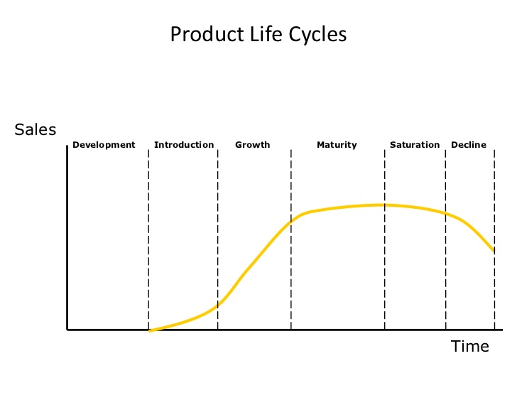
BVRIT HYDERABAD College of Engineering for Women

Slide 20
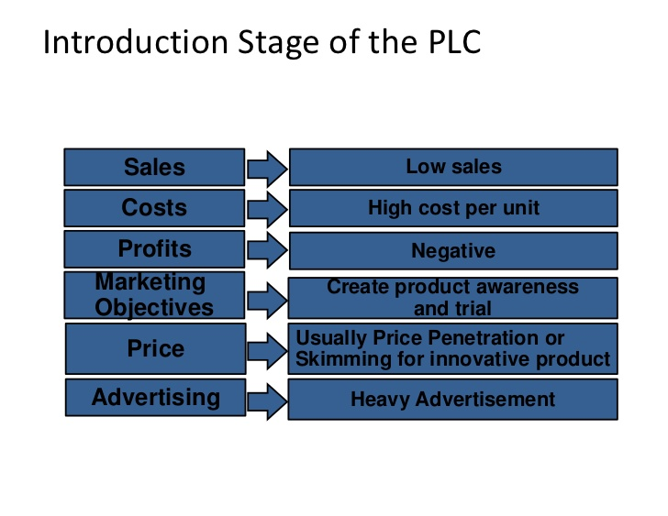
BVRIT HYDERABAD College of Engineering for Women

Slide 21
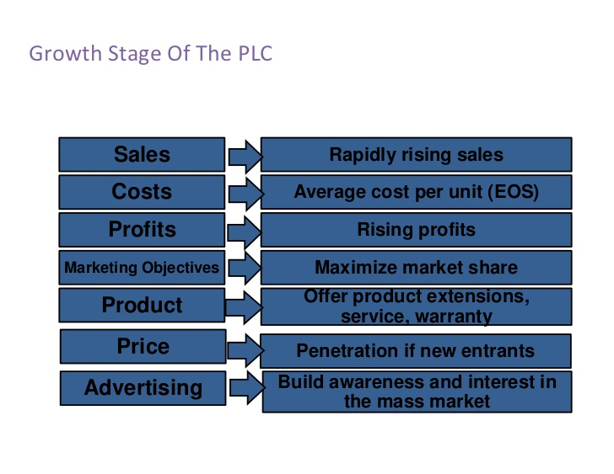
BVRIT HYDERABAD College of Engineering for Women

Slide 22
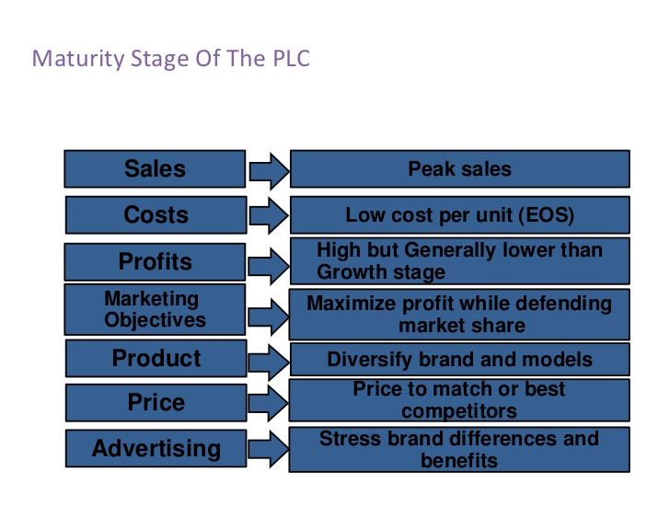
BVRIT HYDERABAD College of Engineering for Women

Slide 23
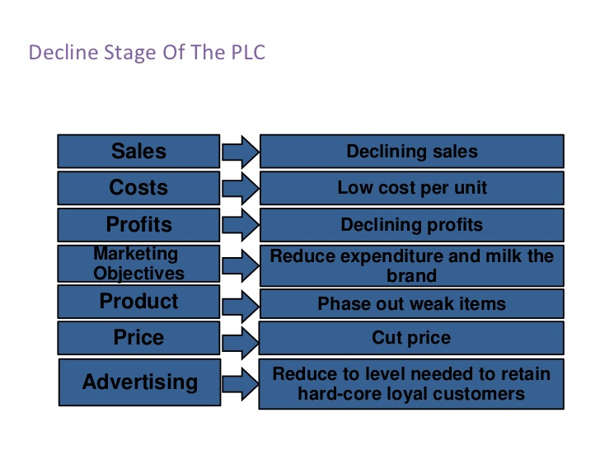
BVRIT HYDERABAD College of Engineering for Women

Slide 24
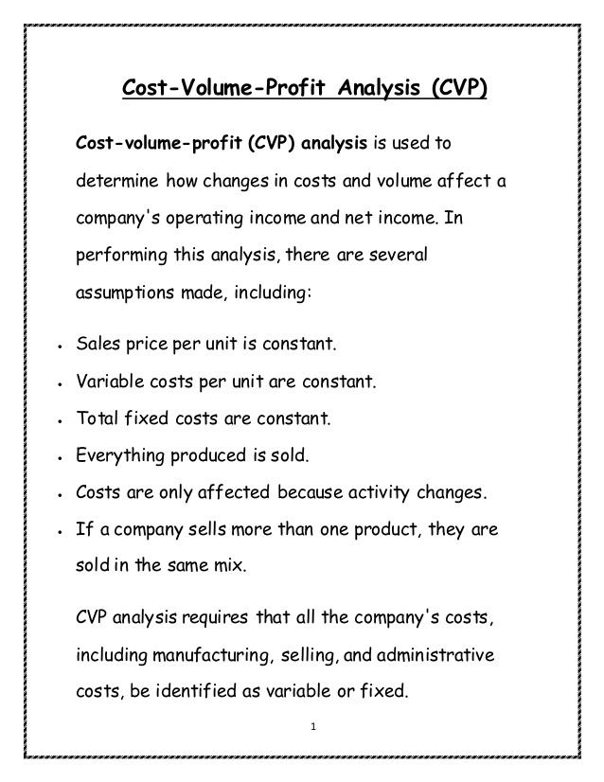

BVRIT HYDERABAD College of Engineering for Women

Slide 25
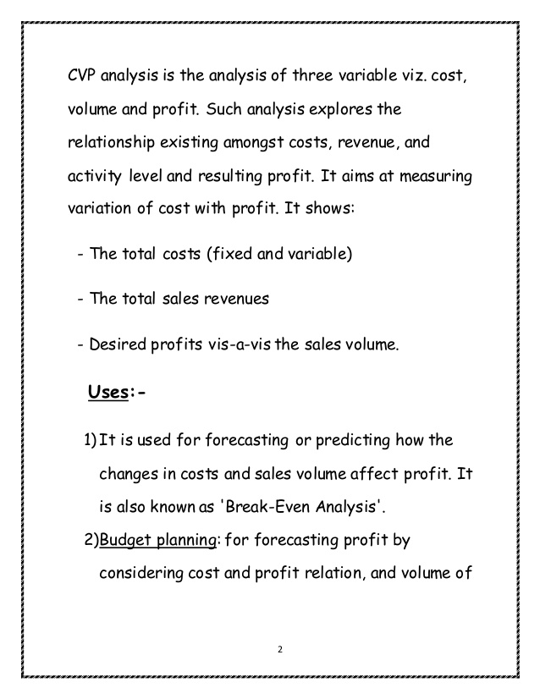
BVRIT HYDERABAD College of Engineering for Women

Slide 26
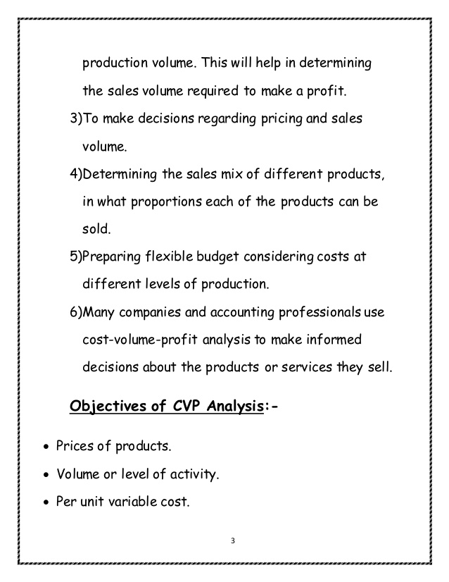
BVRIT HYDERABAD College of Engineering for Women

Slide 27
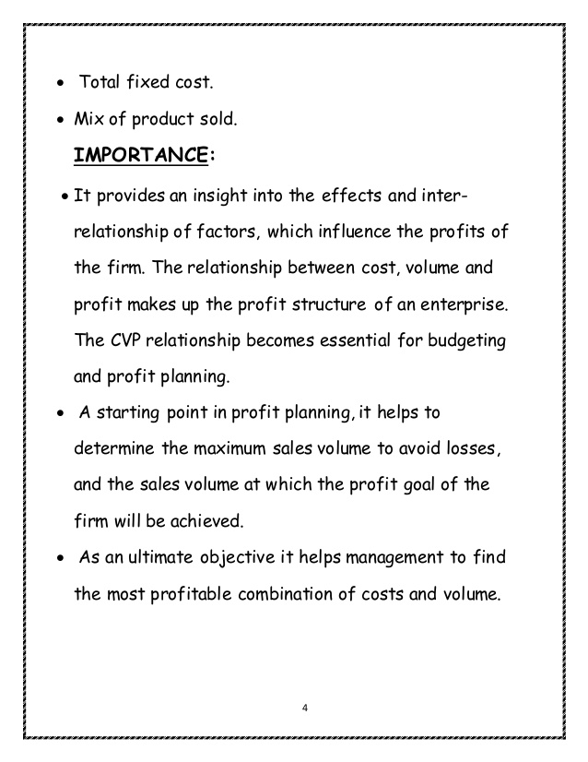
BVRIT HYDERABAD College of Engineering for Women

Slide 28
Types of Costs
A cost is the value of money that has been used up to produce something.
There are different types of costs involved in manufacturing a commodity.
BVRIT HYDERABAD College of Engineering for Women

Slide 29
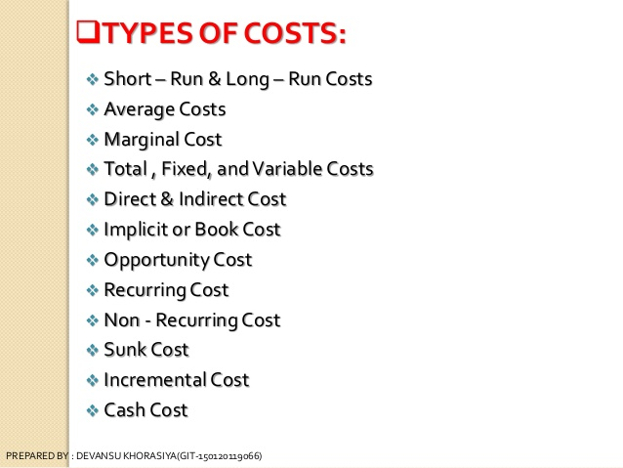
BVRIT HYDERABAD College of Engineering for Women

Slide 30
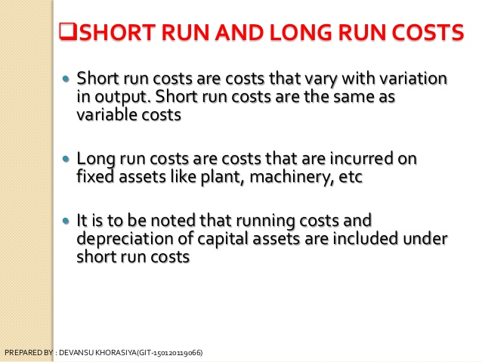
BVRIT HYDERABAD College of Engineering for Women

Slide 31
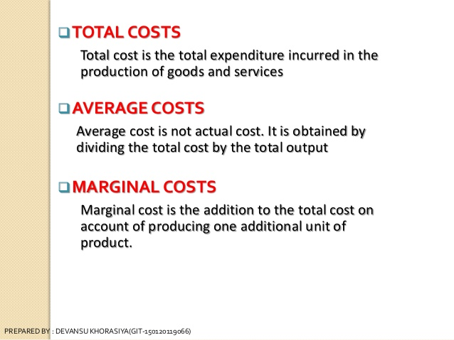
BVRIT HYDERABAD College of Engineering for Women

Slide 32
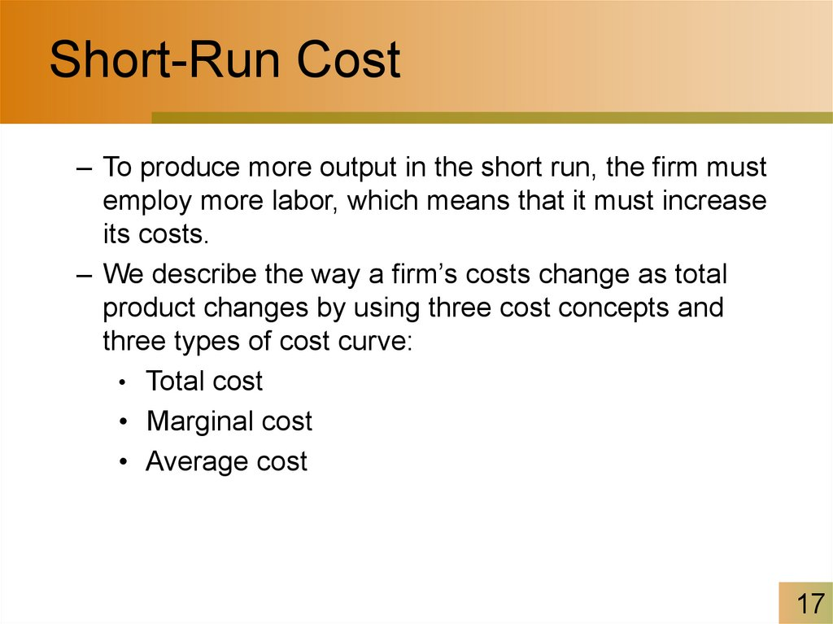
BVRIT HYDERABAD College of Engineering for Women

Slide 33
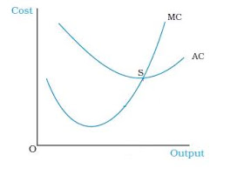
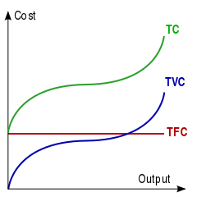
BVRIT HYDERABAD College of Engineering for Women

Slide 34
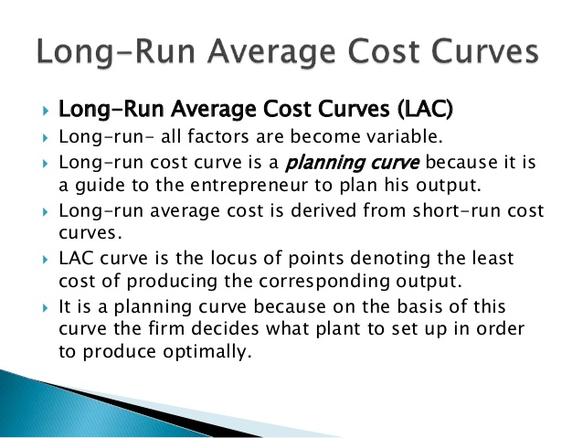
BVRIT HYDERABAD College of Engineering for Women

Slide 35
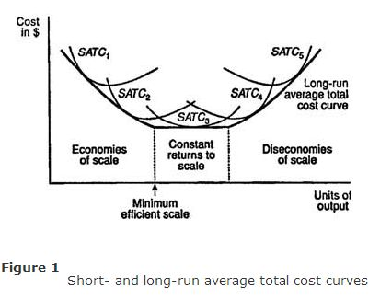
BVRIT HYDERABAD College of Engineering for Women

Slide 36
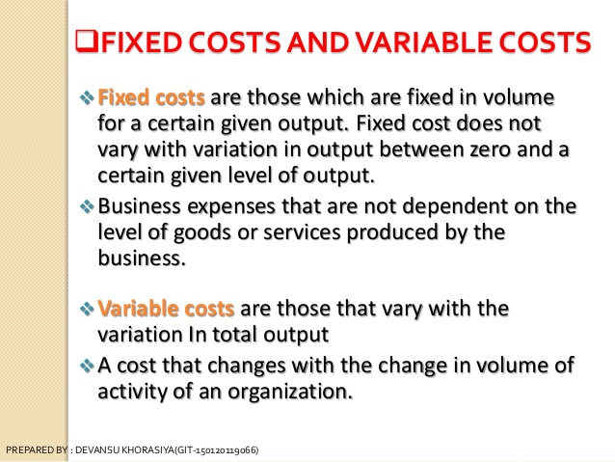
BVRIT HYDERABAD College of Engineering for Women

Slide 37
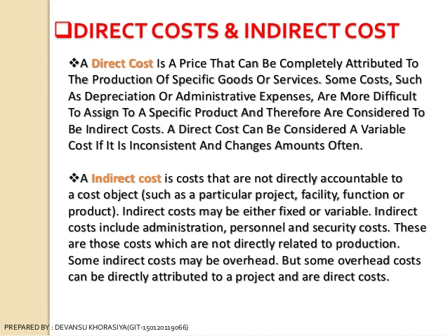
BVRIT HYDERABAD College of Engineering for Women

Slide 38
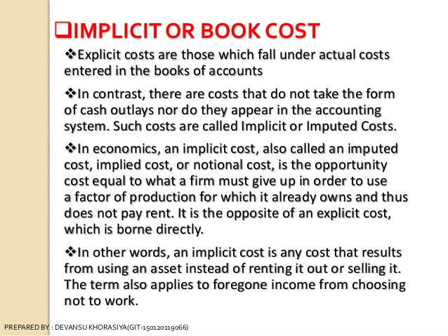
BVRIT HYDERABAD College of Engineering for Women

Slide 39
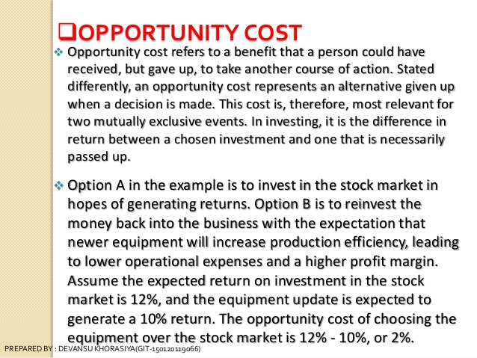
BVRIT HYDERABAD College of Engineering for Women

Slide 40
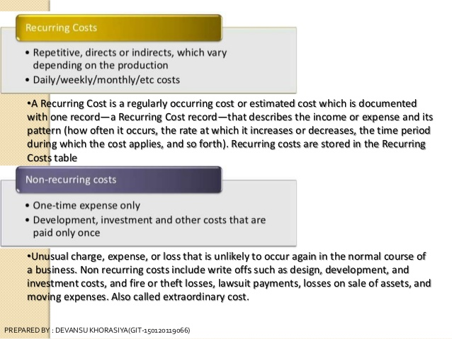
BVRIT HYDERABAD College of Engineering for Women

Slide 41
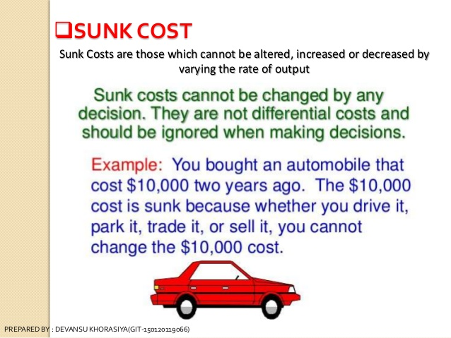
BVRIT HYDERABAD College of Engineering for Women

Slide 42
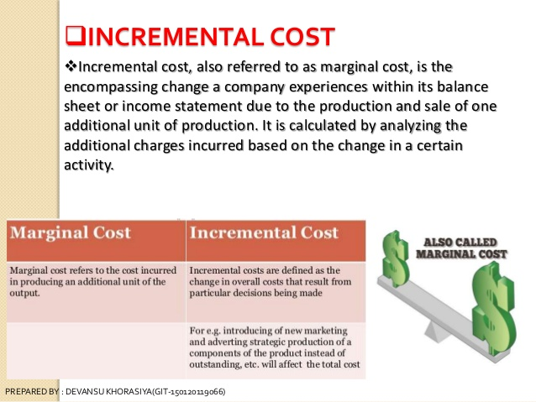
BVRIT HYDERABAD College of Engineering for Women

Slide 43
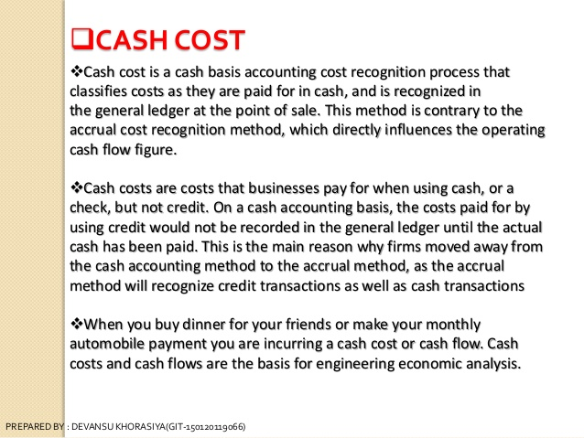
BVRIT HYDERABAD College of Engineering for Women

Slide 44
Sources:
D. D. Chaturvedi, S. L. Gupta, Business
Economics - Theory and Applications, International Book House Pvt. Ltd. 2013.
2. Geethika Ghosh, Piyali Gosh, Purba Roy Choudhury, Managerial Economics, 2e, Tata Mc Graw Hill Education Pvt. Ltd. 2012.
BVRIT HYDERABAD College of Engineering for Women

Slide 45

BVRIT HYDERABAD College of Engineering for Women

